Slide 1
From Collecting, Preserving and Serving to Creating – exploring librarians’ new role: the Case of CR/10 Haihui Zhang/Yue Xu March 22, 2018 Washington D.C.

Slide 2
About CR/10
Original
Neutral
Innovative
Sustainable
Open access
http://culturalrevolution.pitt.edu/

Slide 3
About CR/10 (Cont.)
Current status
108 interview videos
Bilingual subtitles
Collaborative - ULS departments, SUNY-Binghamton, Smithsonian, Penn State, University of North Carolina, UC-Irvine, Georgetown, etc.
Administrative support

Slide 4
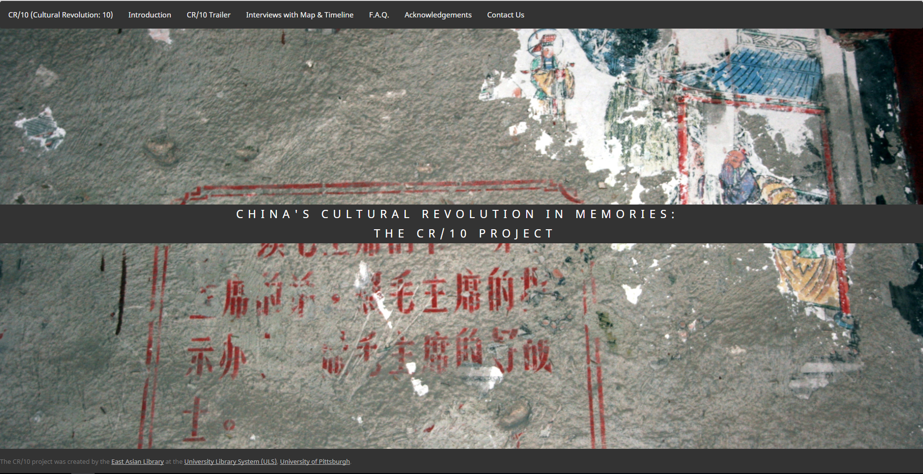
Since CR/10 was uploaded and opened…
This would be a great teaching tool…
Quite fascinating!
It looks fabulous!
A wonderful digital scholarship project with heavy faculty collaboration and thoughtful addresses to the rights and privacy issues, and, most importantly, to preserve part of the important history in a born-digital format.
I will definitely take advantage of this next time I teach my CR seminar.
Excellent!
This is such a great project!
It is terrific…
Your way of making oral history symbolizes a new page in collection building for research libraries that curate collections for East Asian studies.
What a wonderful project!
Very impressive!
It’s very meaningful project to engage CR studies using oral history approach.
You are doing a meaningful job for future generations.
It’s an especially important project in that this is the last decade in which interviewees who can remember 1966-68 are still fit enough to be interviewed.

Slide 5
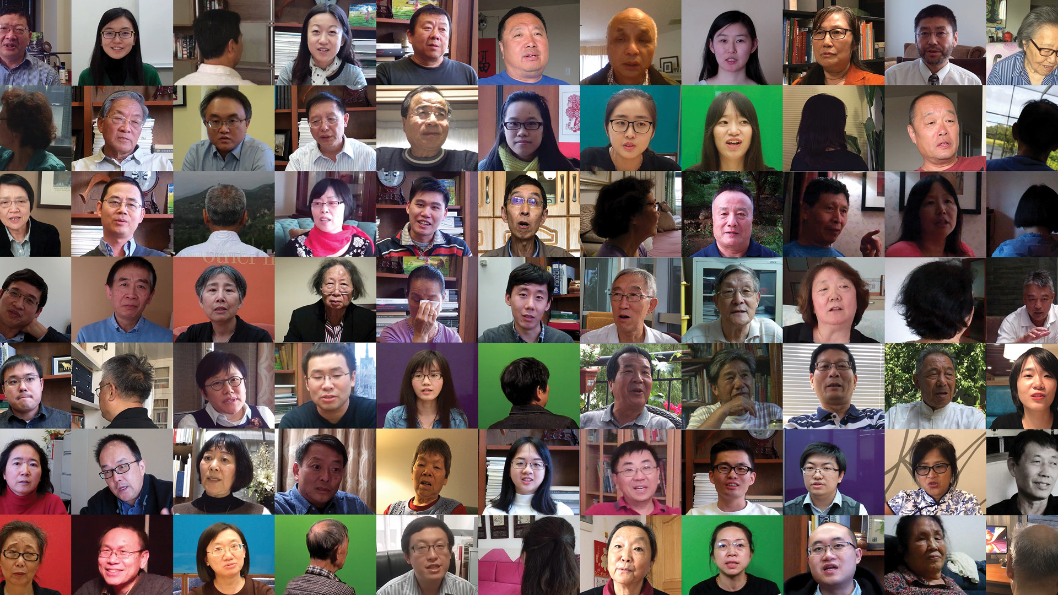
Librarianship Impact & Inquiry
Adapting to change and learning
Librarian’s new role - from a collector, preserver & service provider, to a creator
Build up unique collections
Opportunities for collaboration
WHY LIBRARIANS?

Slide 6
Why Librarians?
Forming an idea
Creating interviews
Editing videos
Creating metadata & cataloging
Archiving & storing
Professional, sustainable open access platform
Publicizing
Scholar
Scholar
Scholar
Librarian
Librarian
Librarian
Librarian
Politician
Librarian
Librarian
Social media reporter
Film maker
Librarian
Media reporter
Film maker
etc.
etc.
etc.
etc.
Libraries welcome contributions from the makers.
Can only be carried out by librarians

Slide 7
haihuiz@pitt.edu yux22@pitt.edu
THANKS

